Slide 1

Geometry
Unit 13, Lesson 9 Classifying Quadrilaterals – Part 2 Volume 2, pg. 334

Slide 2


Benchmarks
MA.912.GR.3.2
Given a mathematical context, use coordinate geometry to classify or justify definitions, properties, and theorems involving circles, triangles, or quadrilaterals.
MA.912.GR.3.3
MA.912.GR.3.3 Use coordinate geometry to solve mathematical and real-world geometric problems involving lines, circles, triangles, and quadrilaterals.
volume 2, pg. 334

Slide 3
Integrated Mathematical Thinking and Reasoning Standards
MA.K12.MTR.1.1 Actively participate in effortful learning both individually and collectively.
MA.K12.MTR.4.1 Engage in discussions that reflect on the mathematical thinking of self and others.
MA.K12.MTR.5.1 Use patterns and structure to help understand and connect mathematical concepts.
MA.K12.MTR.6.1 Assess the reasonableness of solutions.
MA.K12.MTR.7.1 Apply mathematics to real-world contexts.
volume 2, pg. 334

Slide 4

Learning Targets
I can use coordinate geometry to classify quadrilaterals based on their properties in a mathematical or real-world context.
I can use coordinate geometry to solve geometric problems involving quadrilaterals in a mathematical or real-world context.
volume 2, pg. 334

Slide 5

Warm-Up
volume 2, pg. 334

Slide 6
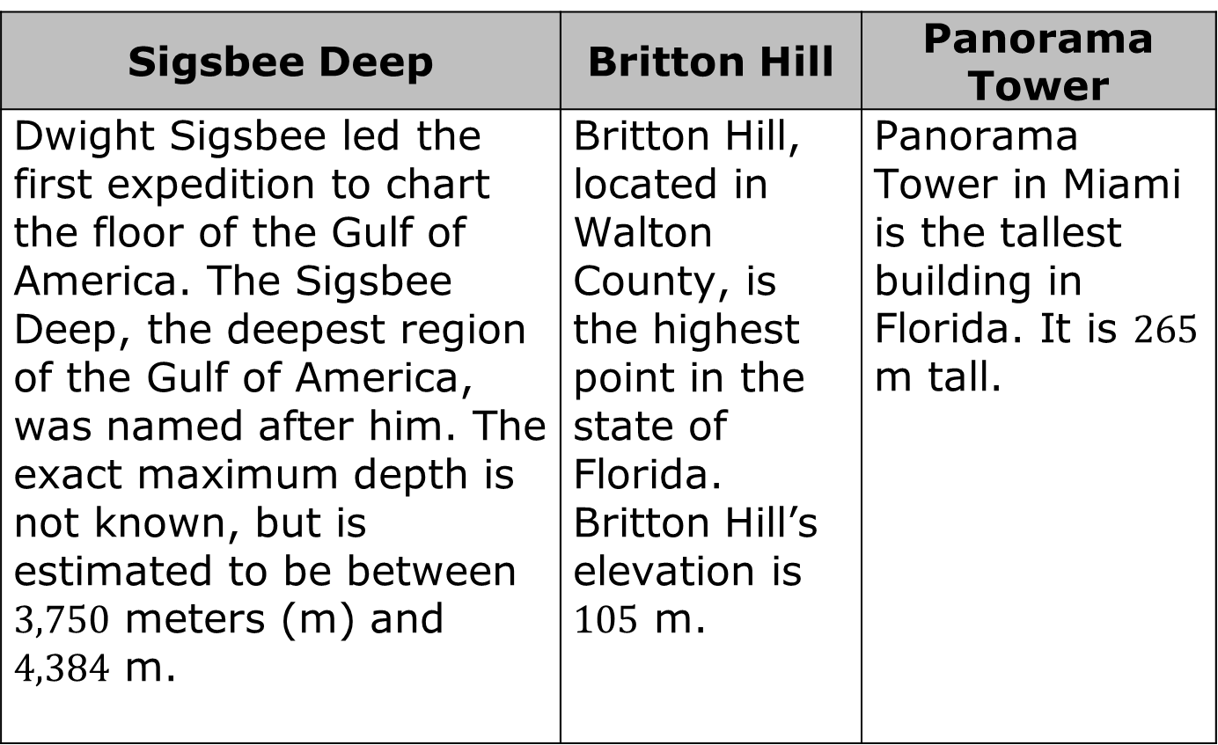
13.9.1 Warm-Up: Between Two Numbers
Sigsbee Deep | Britton Hill | Panorama Tower
Dwight Sigsbee led the first expedition to chart the floor of the Gulf of America. The Sigsbee Deep, the deepest region of the Gulf of America, was named after him. The exact maximum depth is not known, but is estimated to be between $3,750$ meters (m) and $4,384$ m. | Britton Hill, located in Walton County, is the highest point in the state of Florida. Britton Hill’s elevation is $105$ m. | Panorama Tower in Miami is the tallest building in Florida. It is $265$ m tall.
volume 2, pg. 334

Slide 7
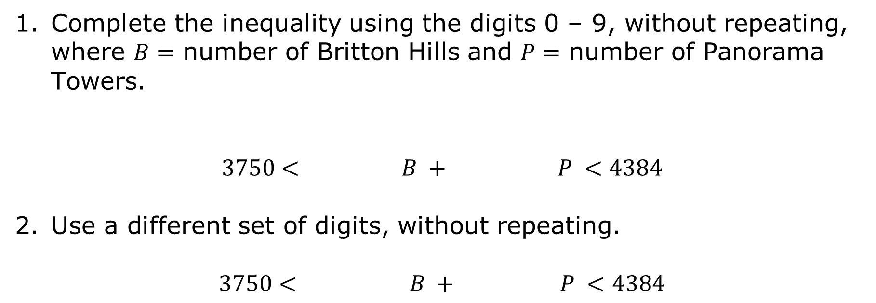
Complete the inequality using the digits 0 – 9, without repeating, where $B=$ number of Britton Hills and $P=$ number of Panorama Towers.
$$3750< B + P <4384$$
Use a different set of digits, without repeating.
$$3750< B + P <4384$$
volume 2, pg. 334

Slide 8

Collaboration
volume 2, pg. 335

Slide 9

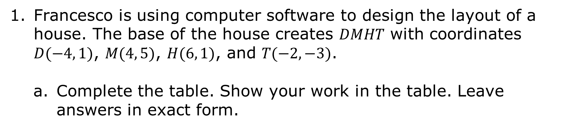
13.9.2 Collaboration: Real-World Quadrilaterals
Francesco is using computer software to design the layout of a house. The base of the house creates 𝐷𝑀𝐻𝑇 with coordinates $D(−4, 1)$, $M(4, 5)$, $H(6, 1)$, and $T(−2,−3)$.
Complete the table. Show your work in the table. Leave answers in exact form.
volume 2, pg. 335

Slide 10
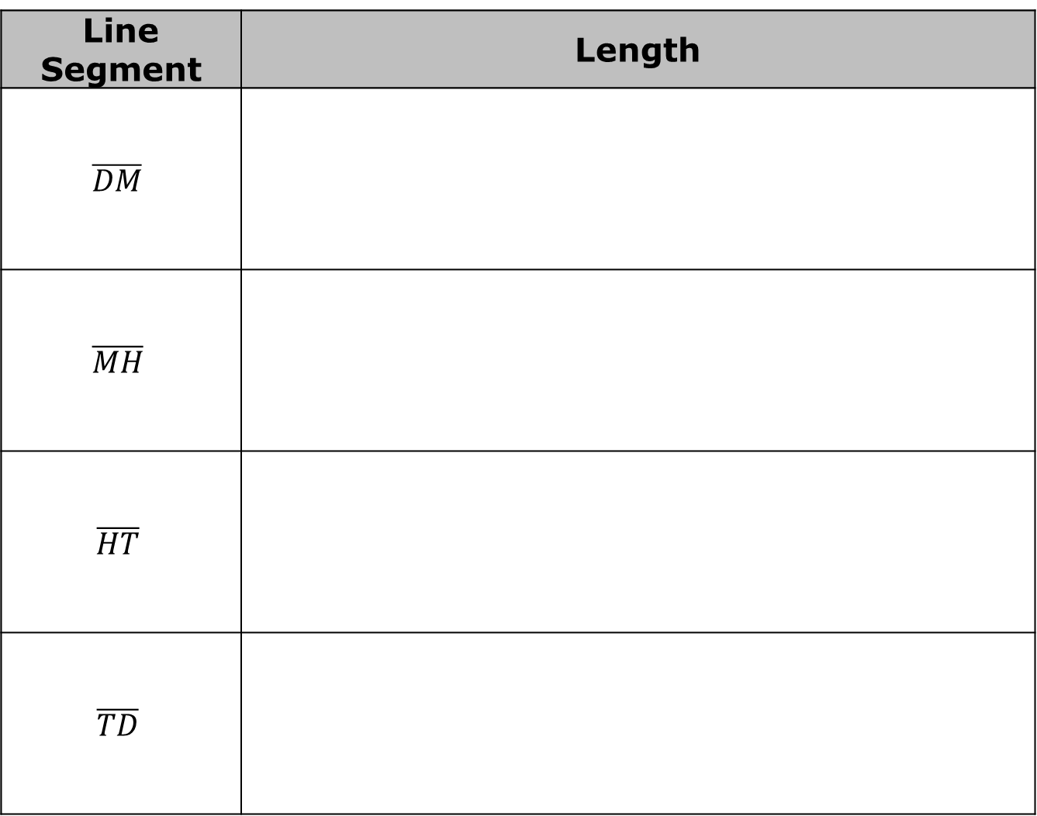
Line Segment | Length
$$\overline{DM}$$
$$\overline{MH}$$
$$\overline{HT}$$
$$\overline{TD}$$
volume 2, pg. 335

Slide 11
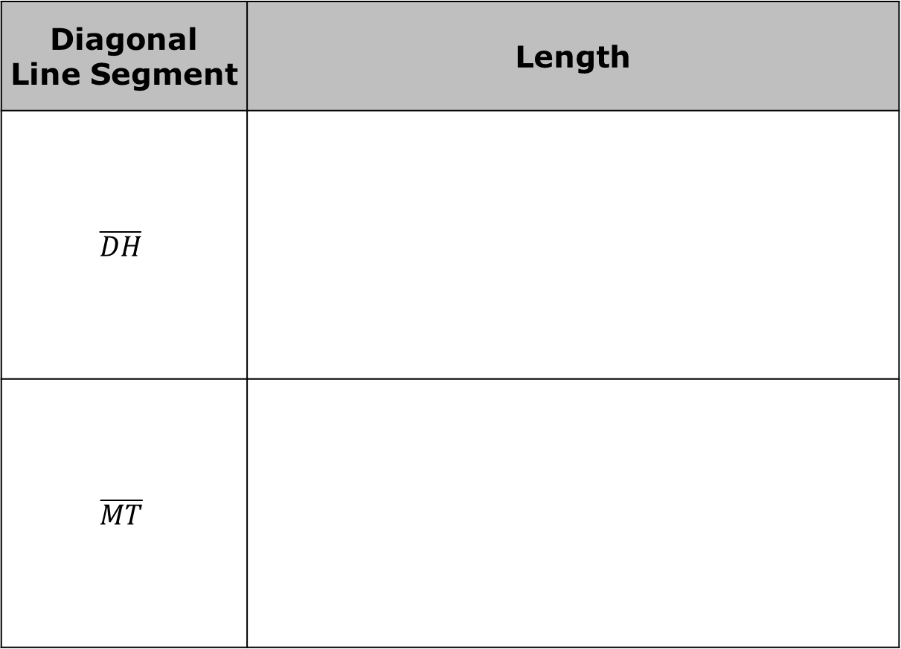
Complete the table. Show your work in the table. Leave answers in exact form.
Diagonal Line Segment | Length
$$\overline{DH}$$
$$\overline{MT}$$
volume 2, pg. 335

Slide 12
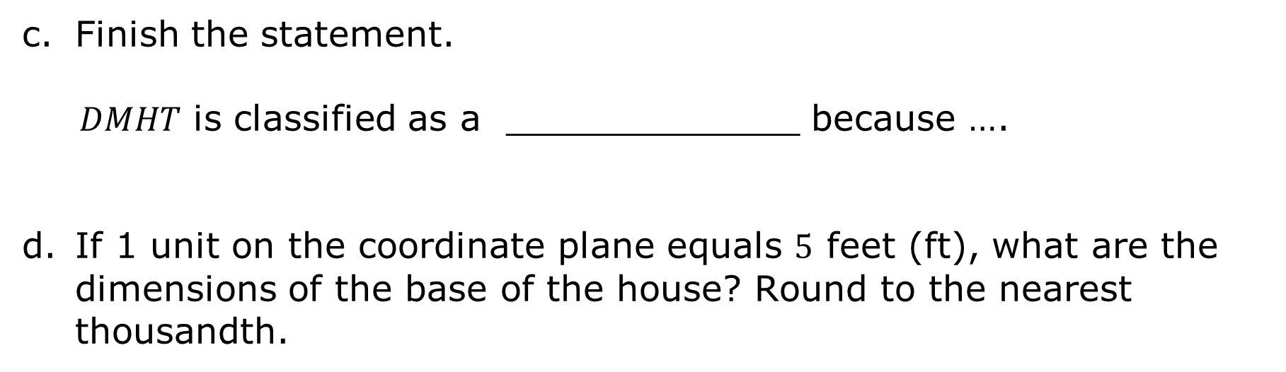
Finish the statement.
𝐷𝑀𝐻𝑇 is classified as a _____________ because ….
If 1 unit on the coordinate plane equals $5$ feet (ft), what are the dimensions of the base of the house? Round to the nearest thousandth.
volume 2, pg. 335

Slide 13
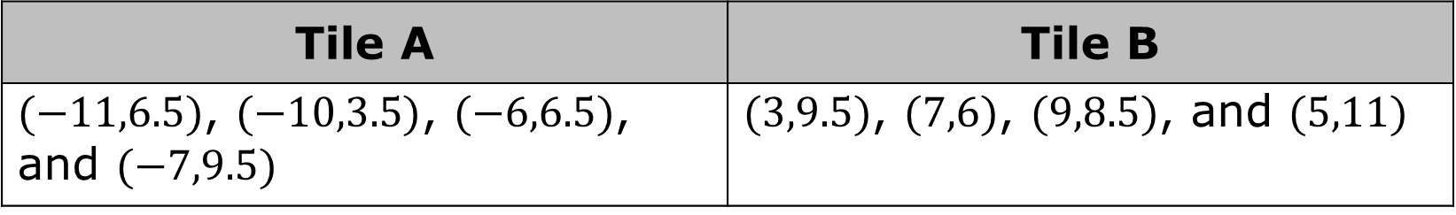
Jillian is determining which type of tile to place on the floor. She wants a tile in the shape of a parallelogram. The vertices of the tile options are shown.
Tile A | Tile B
$(−11,6.5)$, $(−10,3.5)$, $(−6,6.5)$, and $(−7,9.5)$ | $(3,9.5)$, $(7,6)$, $(9,8.5)$, and $(5,11)$
volume 2, pg. 336

Slide 14
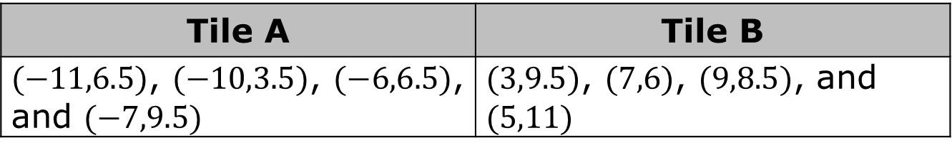
Tile A | Tile B
$(−11,6.5)$, $(−10,3.5)$, $(−6,6.5)$, and $(−7,9.5)$ | $(3,9.5)$, $(7,6)$, $(9,8.5)$, and $(5,11)$
Which tile should Jillian pick if she wants a tile in the shape of a parallelogram?
Explain your choice by listing the properties of parallelograms that were applied.
volume 2, pg. 336

Slide 15
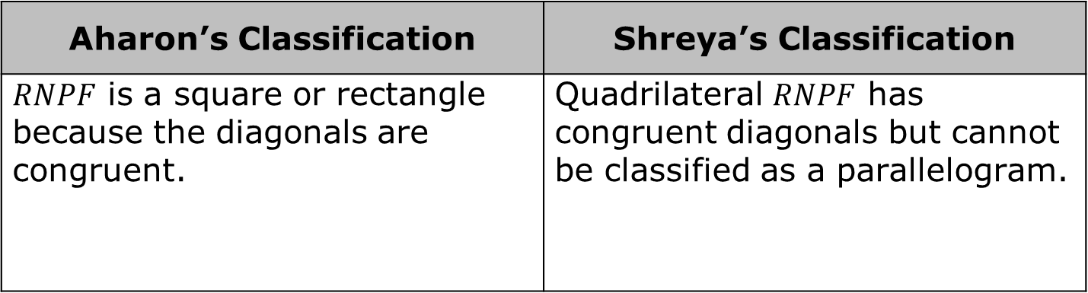
Aharon and Shreya classified 𝑅𝑁𝑃𝐹 with vertices at $R(−3,7)$, $N(−1,7)$, $P(−3,2)$, and $F(−5,4)$. Their classifications are shown.
Aharon’s Classification | Shreya’s Classification
$RNPF$ is a square or rectangle because the diagonals are congruent. | Quadrilateral $RNPF$ has congruent diagonals but cannot be classified as a parallelogram.
Whose classification do you agree with? Justify your answer using properties.
Write a note to the person whose classification is incorrect, explaining their mistake.
volume 2, pg. 336

Slide 16
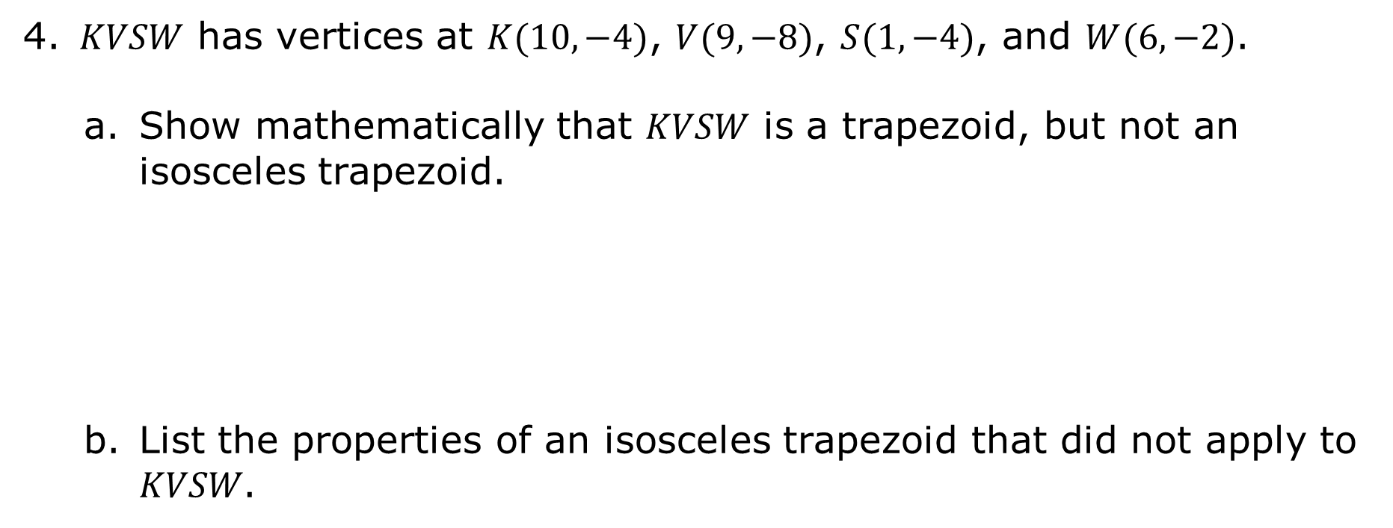
𝐾𝑉𝑆𝑊 has vertices at $K(10,−4)$, $V(9,−8)$, $S(1,−4)$, and $W(6,−2)$.
Show mathematically that 𝐾𝑉𝑆𝑊 is a trapezoid, but not an isosceles trapezoid.
List the properties of an isosceles trapezoid that did not apply to 𝐾𝑉𝑆𝑊.
volume 2, pg. 337

Slide 17
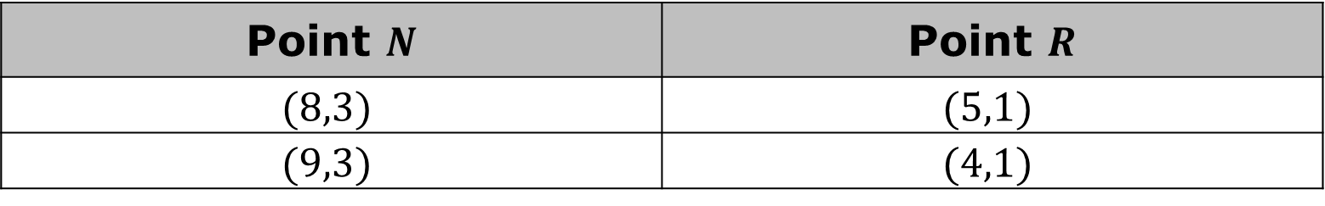
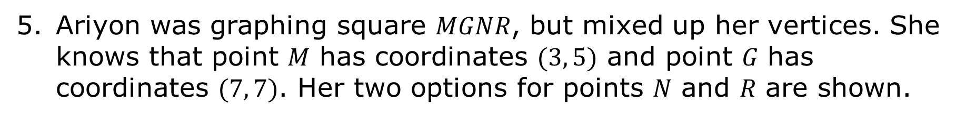
Ariyon was graphing square 𝑀𝐺𝑁𝑅, but mixed up her vertices. She knows that point 𝑀 has coordinates $(3, 5)$ and point 𝐺 has coordinates $(7, 7)$. Her two options for points 𝑁 and 𝑅 are shown.
Point $N$ | Point $R$
$$(8,3)$$ | $$(5,1)$$
$$(9,3)$$ | $$(4,1)$$
Which coordinates are correct for points 𝑁 and 𝑅? Justify your answer or show your work.
Which properties of a square did you use to determine the correct points 𝑁 and 𝑅?
volume 2, pg. 337

Slide 18

Your Turn
volume 2, pg. 338

Slide 19
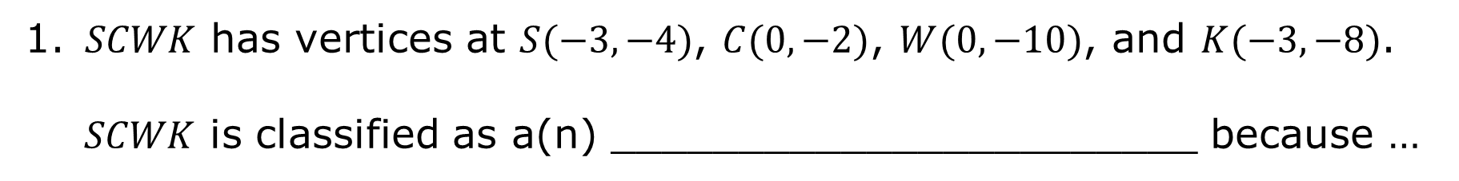
13.9.3 Your Turn!
𝑆𝐶𝑊𝐾 has vertices at $S(−3,−4)$, $C(0,−2)$, $W(0,−10)$, and $K(−3,−8)$.
𝑆𝐶𝑊𝐾 is classified as a(n) _______________________ because …
volume 2, pg. 338

Slide 20
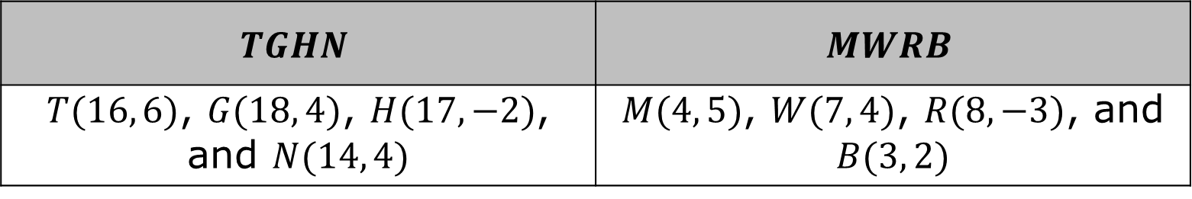
Ziquan is designing a template for his 3D printer. He created two quadrilaterals using his software.
$$TGHN$$ | $$MWRB$$
$T(16, 6)$, $G(18, 4)$, $H(17,−2)$, and $N(14, 4)$ | $M(4, 5)$, $W(7, 4)$, $R(8,−3)$, and $B(3, 2)$
Which quadrilateral can be classified as a kite? Show your work.
volume 2, pg. 338

Slide 21

List the properties of a kite that you used.
If 1 unit on the coordinate plane equals $6$ inches (in), what are the measurements of the sides of the kite? Round to the nearest thousandth.
volume 2, pg. 338

Slide 22

Wrap-Up
volume 2, pg. 339

Slide 23
13.9.4 Wrap-Up: Reflection
Place an X on the line in relation to how you feel about today’s learning target.
I can use coordinate geometry to classify quadrilaterals based on their properties in a mathematical or real-world context.
I need help. I can’t get started. | I’m getting there. | I understand and have evidence.
volume 2, pg. 339

